Slide 1
Big Mountain Resort Ticket Pricing

Slide 2
Problem Identification
Context: Recently an additional chair lift was added, increasing operational costs by $1.54M. In return, this will allow us to increase ticket prices.
Goal: Increase next season’s revenues by 10% by implementing changes that will allow us to increase ticket prices

Slide 3
Recommendation & Key Findings
We excel in features that customers value such as:
Vertical drop
Snow making
Number of runs
Number of fast quads
This means that we can charge $95.87 per ticket instead of the current price of $81.00 (predicted by ML model)

Slide 4
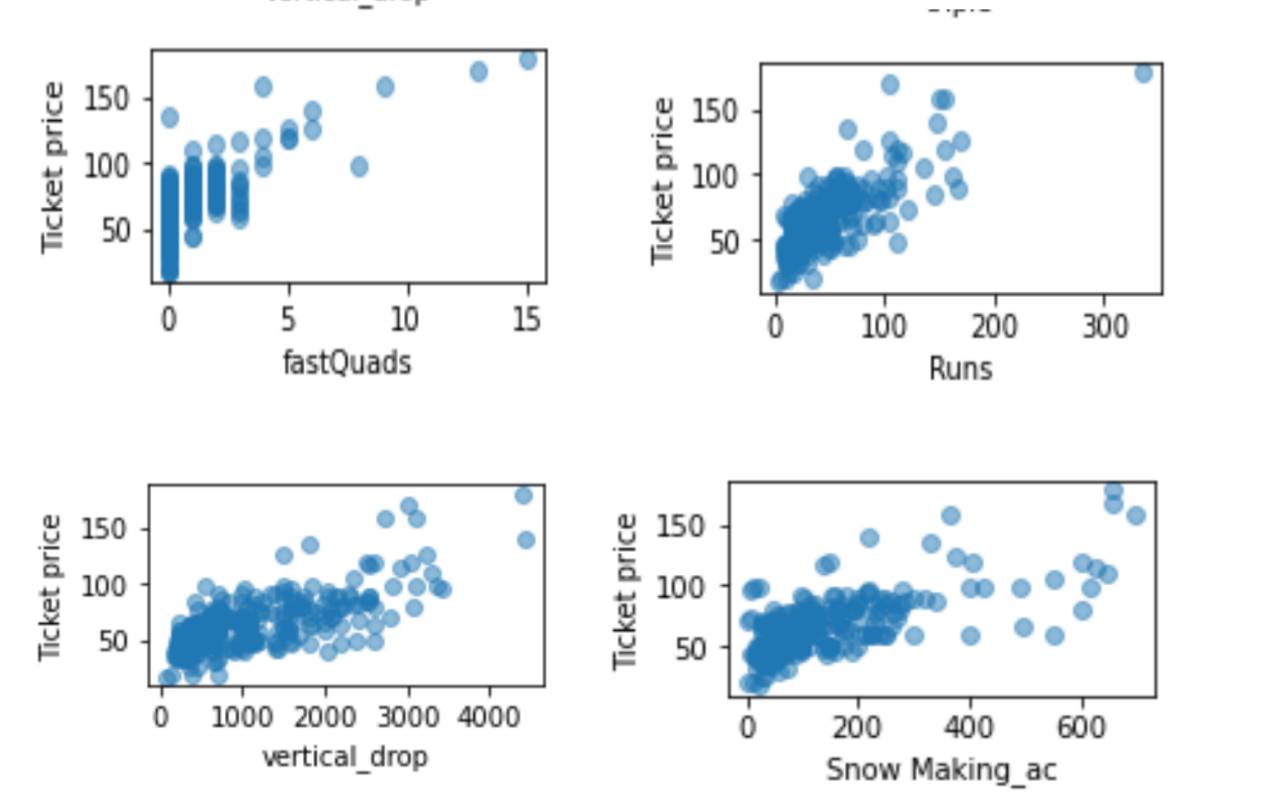
Modeling results & analysis
The four features that positively impact ticket prices are:
fast quads
runs
vertical drop
snow making

Slide 5
Modeling results & analysis
Two different ML models were tried:
Linear regression
Random forest regressor
It’s shown that the random forest regressor fits our data better. Thus, the next analysis will be done based on this regression model’s results.
 | Mean Absolute Error | R^2
Linear Regression | 9.2 | 0.63
Random Forest Regressor | 8.3 | 0.7

Slide 6
Modelling results & analysis
Findings with Random Forest Regressor:
Based on our current facilities, we can charge a ticket price of $95.87
Adding another run and increasing vertical drop by 150ft can increase revenues by $3.47M
Operational cost of our additional chair lift is $1.54M
This means that we are making positive net profit from the chair lift

Slide 7
Summary & Conclusion
We can charge $95.87 per ticket as opposed to our current $81.00
If we add another run and increase vertical drop by 150ft, we can increase revenues by $3.47M
We have a regression model that will project ticket prices if we were to update our facilities

